Slide 1

Topic Multi-layer Perceptron
CSE465
CSE465: Pattern Recognition and Neural Network
Sec: 1
Summer 2025

Slide 2
Today’s Topic
Multi layer perceptron
Problems with Perceptron
MLP Notation
Forward Propagation
Loss function
Gradient Descent
Backpropagation

Slide 3
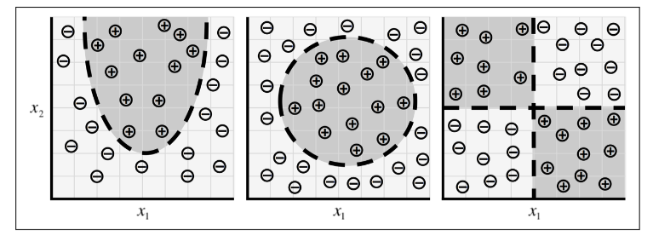
Limitation of a Perceptron
Works only with linear or “sort-of” linear data
Solution:
Multi-layer Perceptron (a.k.a. Artificial Neural Network)

Slide 4
The problem
Not line
=> curve
Perceptron doesn’t work on a dataset like this, as perceptron ends up with a line. We need a curve as the decision boundary.
Challenge: we can only use Perceptron(s) to build such a system.

Slide 5
Emergence of multi-layer perceptron (MLP)

Slide 6
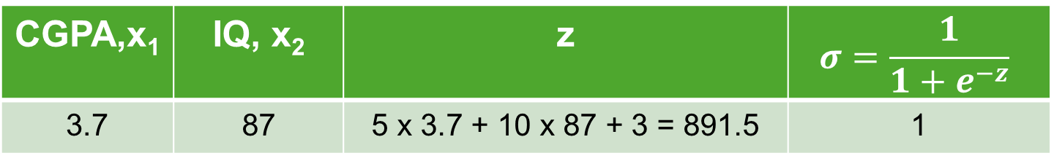
Perceptron with Sigmoid
5x+10y+3=0
1
b
w₂
Σ
𝝈
x₂
z
w₁
x₁
CGPA,x₁ | IQ, x₂ | z | $$σ=\frac{1}{1+e^{−z}}$$
3.7 | 87 | 5 x 3.7 + 10 x 87 + 3 = 891.5 | 1

Slide 7






MLP Intuition
w₁ = 2, w₂ = 3, b = 6
2x+3y+6=0
1
b
w₂
Σ
𝝈
x₂
z
x₁
w₁
Smoothing
w₁ = 5, w₂ = 4, b = 3
1
b
w₂
Σ
𝝈
x₂
z
x₁
w₁
5x+4y+3=0

Slide 8
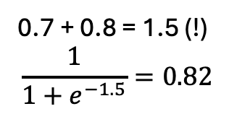
MLP: Mathematics
P(y) = 0.7
Therefore,
First take addition of perceptrons.
Then apply sigmoid as activation.
P(y) = 0.8
0.7 + 0.8 = 1.5 (!)
$$\frac{1}{1+e^{−1.5}}=0.82$$
𝝈

Slide 9



MLP: Mathematics (further enhancements)
P(y) = 0.7
Suppose we want the effect of Perceptron-1 more
P(y) = 0.8

Slide 10
MLP: Mathematics (further enhancements)
P(y) = 0.7
Suppose we want the effect of Perceptron-1 more
10
0.7 x 10 + 0.8 x 5 = z
𝜎(z)
5
P(y)
P(y) = 0.8
Instead of normal sum, we have to do weighted sum.
You can even add some “bias”

Slide 11
MLP: Mathematics (further enhancements)
x₁
b = 3
W₁ =10
So the entire thing works as a Perceptron, where the inputs are the outputs of the 2 perceptrons.
𝝈
W₂ =5
x₂
That is, it is a multi-layered perceptron
b=3
w₂
Σ
𝝈
x₂
z
x₁
w₁

Slide 12



MLP: Formation
cgpa
2
2x+3y+6=0
6
3
10
iq
10
3
cgpa
5
5
3
5
iq
4
cgpa
2
6
10
5x+4y+3=0
3
3
$$\hat{y}$$
iq
5
3
5
4
Input layer
Output layer
Hidden layer

Slide 13
MLP: Formation with more flexibility
Adding nodes in hidden layer
Additional and more complex non-linearity can be captured
CGPA
IQ
Input layer
Output layer
Hidden layer

Slide 14
MLP: Formation with more flexibility
Adding nodes in input layer (with extra features)
CGPA
IQ
Contest rating

Slide 15
MLP: Formation with more flexibility
Adding nodes in output layer
CGPA
Used in multi-class classification.
E.g. Object classification
IQ
Input layer
Hidden layer
Output layer

Slide 16
MLP: Formation with more flexibility
Adding more hidden layers (Deep Neural Network, a.k.a. Universal Function approximator)
CGPA
IQ
Input layer
Hidden layer # 1
Hidden layer # 2
Output layer

Slide 17
MLP/ANN Notation

Slide 18

MLP Notation
Q1: What is the total number of trainable parameters for a neural network?
x_{i1}
x_{i2}
$${\hat{y}}_{i}$$
Data → {m x n}
m → No. of rows (samples)
n → number of input features
Each row is denoted by x_{i}
x_{i3}
Output layer
x_{i4}
Hidden layer # 2
Input layer
Hidden layer # 1

Slide 19
MLP Notation
4 * 3 = 12
weights
3 biases
Q1: What is the total number of trainable parameters for a neural network?
x_{i1}
3 * 2 = 6
weights
2 biases
x_{i2}
2 * 1 = 2
weights
1 biases
$${\hat{y}}_{i}$$
Layer 1
Layer 2
Layer 3
x_{i3}
Output layer
x_{i4}
Total parameters = (12 + 3) + (6 + 2) + (2 + 1)
= 26
Hidden layer # 2
Input layer
Hidden layer # 1

Slide 20





















MLP Notation
i : layer no.
j : node no.
x_{i1}
$$w_{11}^{1}$$
Bias ➔ b_{ij} ➔
$$w_{13}^{1}$$
$$w_{12}^{1}$$
b₁₁
o₁₁
$$w_{21}^{1}$$
$$w_{11}^{2}$$
x_{i2}
$$w_{12}^{2}$$
b₂₁
o₂₁
i : layer no.
j : node no.
$$w_{22}^{1}$$
o₁₂
$$w_{11}^{3}$$
Output ➔ o_{ij} ➔
$$w_{23}^{1}$$
b₁₂
$$w_{21}^{2}$$
o₃₁
$$w_{31}^{1}$$
$$w_{32}^{1}$$
b₃₁
$${\hat{y}}_{i}$$
x_{i3}
$$w_{33}^{1}$$
$$w_{22}^{2}$$
o₂₂
$$w_{31}^{2}$$
b₂₂
$$w_{21}^{3}$$
$$w_{41}^{1}$$
$$w_{42}^{1}$$
b₁₃
$$w_{32}^{2}$$
Output layer
x_{i4}
o₁₃
k : layer no. it’s going into
i : node no. in the source layer
j : node no. in the destination layer
$$w_{43}^{1}$$
Hidden layer # 2
(layer # 3)
Weights ➔ $w_{ij}^{k}$ ➔
Input layer
Hidden layer # 1
(layer # 0)

Slide 21
Forward Propagation

Slide 22
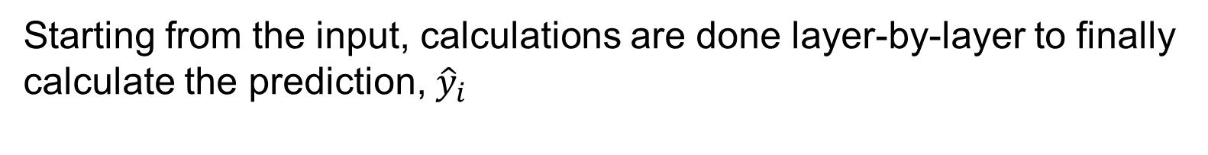

Forward Propagation
x_{i1}
x_{i2}
$${\hat{y}}_{i}$$
x_{i3}
x_{i4}
Starting from the input, calculations are done layer-by-layer to finally calculate the prediction, ${\hat{y}}_{i}$

Slide 23
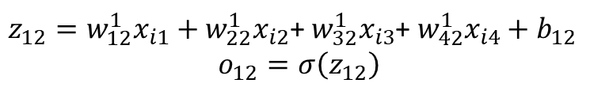
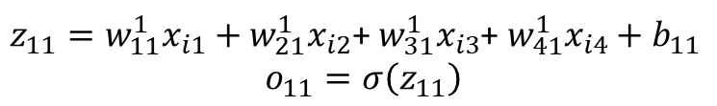


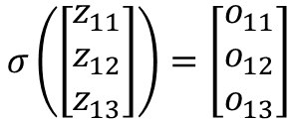

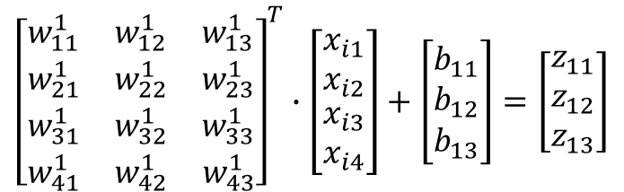

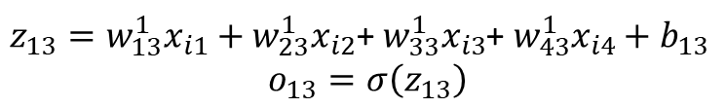
Forward Propagation: layer 1
$z_{11}=w_{11}^{1}x_{i1}+w_{21}^{1}x_{i2}$+ $w_{31}^{1}x_{i3}$+ $w_{41}^{1}x_{i4}+b_{11}$
$$o_{11}=σ\left(z_{11}\right)$$
x_{i1}
$$w_{11}^{1}$$
$$w_{21}^{1}$$
b₁₁
o₁₁
x_{i2}
$$w_{31}^{1}$$
$$w_{41}^{1}$$
$z_{12}=w_{12}^{1}x_{i1}+w_{22}^{1}x_{i2}$+ $w_{32}^{1}x_{i3}$+ $w_{42}^{1}x_{i4}+b_{12}$
$$o_{12}=σ\left(z_{12}\right)$$
b₁₂
o₁₂
$${\hat{y}}_{i}$$
x_{i3}
$z_{13}=w_{13}^{1}x_{i1}+w_{23}^{1}x_{i2}$+ $w_{33}^{1}x_{i3}$+ $w_{43}^{1}x_{i4}+b_{13}$
$$o_{13}=σ\left(z_{13}\right)$$
b₁₃
o₁₃
Fortunately, this can be done easily using matrix calculation
x_{i4}
$${\left[\begin{matrix}w_{11}^{1} & w_{12}^{1} & w_{13}^{1} \\ w_{21}^{1} & w_{22}^{1} & w_{23}^{1} \\ \begin{matrix}w_{31}^{1} \\ w_{41}^{1}\end{matrix} & \begin{matrix}w_{32}^{1} \\ w_{42}^{1}\end{matrix} & \begin{matrix}w_{33}^{1} \\ w_{43}^{1}\end{matrix}\end{matrix}\right]}^{T}∙\left[\begin{matrix}x_{i1} \\ x_{i2} \\ \begin{matrix}x_{i3} \\ x_{i4}\end{matrix}\end{matrix}\right]+\left[\begin{matrix}b_{11} \\ b_{12} \\ b_{13}\end{matrix}\right]=\left[\begin{matrix}z_{11} \\ z_{12} \\ z_{13}\end{matrix}\right]$$
$$σ\left(\left[\begin{matrix}z_{11} \\ z_{12} \\ z_{13}\end{matrix}\right]\right)=\left[\begin{matrix}o_{11} \\ o_{12} \\ o_{13}\end{matrix}\right]$$

Slide 24
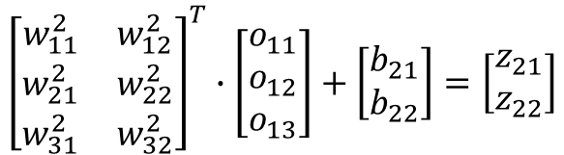
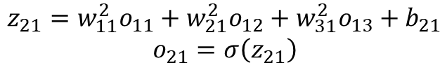




Forward Propagation: layer 3 / Output layer
$$z_{21}=w_{11}^{2}o_{11}+w_{21}^{2}o_{12}+w_{31}^{2}o_{13}+b_{21}$$
$$o_{21}=σ\left(z_{21}\right)$$
x_{i1}
o₁₁
$$w_{11}^{2}$$
$$z_{22}=w_{12}^{2}o_{11}+w_{22}^{2}o_{12}+w_{32}^{2}o_{13}+b_{22}$$
$$o_{22}=σ\left(z_{22}\right)$$
x_{i2}
$$w_{21}^{2}$$
b₂₁
o₂₁
o₁₂
$$w_{31}^{2}$$
o₃₁
$${\hat{y}}_{i}$$
b₃₁
x_{i3}
b₂₂
o₂₂
o₁₃
Fortunately, this can be done easily using matrix calculation
x_{i4}
$${\left[\begin{matrix}w_{11}^{2} & w_{12}^{2} \\ w_{21}^{2} & w_{22}^{2} \\ w_{31}^{2} & w_{32}^{2}\end{matrix}\right]}^{T}∙\left[\begin{matrix}o_{11} \\ o_{12} \\ o_{13}\end{matrix}\right]+\left[\begin{matrix}b_{21} \\ b_{22}\end{matrix}\right]=\left[\begin{matrix}z_{21} \\ z_{22}\end{matrix}\right]$$
$$σ\left(\left[\begin{matrix}z_{21} \\ z_{22}\end{matrix}\right]\right)=\left[\begin{matrix}o_{21} \\ o_{22}\end{matrix}\right]$$

Slide 25
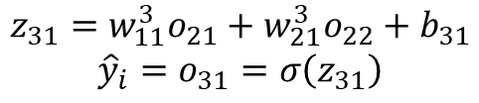

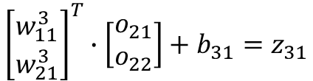


Forward Propagation: layer 2
$$z_{31}=w_{11}^{3}o_{21}+w_{21}^{3}o_{22}+b_{31}$$
$${\hat{y}}_{i}=o_{31}=σ\left(z_{31}\right)$$
x_{i1}
x_{i2}
o₂₁
$$w_{11}^{3}$$
o₃₁
b₃₁
$${\hat{y}}_{i}$$
x_{i3}
$$w_{21}^{3}$$
o₂₂
Fortunately, this can be done easily using matrix calculation
x_{i4}
$${\left[\begin{matrix}w_{11}^{3} \\ w_{21}^{3}\end{matrix}\right]}^{T}∙\left[\begin{matrix}o_{21} \\ o_{22}\end{matrix}\right]+b_{31}=z_{31}$$
$$σ\left(z_{31}\right)=o_{31}={\hat{y}}_{i}$$

Slide 26
Loss Functions in deep learning

Slide 27
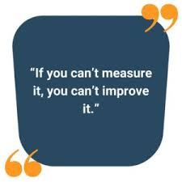
What is Loss Function?
A method of evaluating how well your algorithm is modelling your dataset.
Usually high loss → poor performance
Low loss → great performance
In ML/DL, loss is a function of the model parameters.
Why is loss function important?

Slide 28

Loss function in ML (Linear Regression)
Loss, $SE={\left(y_{i}−{\hat{y}}_{i}\right)}^{2}$
Goal: Find the line that minimizes the “Loss”

Slide 29


Loss function in Deep Learning
CGPA | IQ | Package (Lakh)
7.1 | 83 | 3.2
8.5 | 91 | 4.5
6.3 | 102 | 6.1
5.1 | 87 | 2.7
… | … | …
… | … | …
… | … | …
3.7
b₁₁
4.3
CGPA
b₁₂
b₂₁
$${\hat{y}}_{i}$$
IQ
b₁₃
$$L={\left(y_{i}−{\hat{y}}_{i}\right)}^{2}$$
Forward Propagation
The weights and biases are initialized randomly.
After every iteration, these parameters are “adjusted” to pull down the loss.

Slide 30


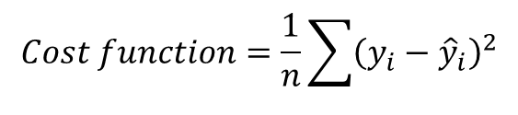
Loss function vs Cost function
Loss function: Error in single training
Cost function: Error in the entire batch
b₁₁
CGPA
b₁₂
b₂₁
$${\hat{y}}_{i}$$
CGPA | IQ | Package (Lakh) | Prediction
6.3 | 100 | 6.3 | 6.1
7.1 | 91 | 4.1 | 4
8.5 | 83 | 3.5 | 3.7
9.2 | 102 | 7.2 | 7
IQ
b₁₃
$$L={\left(y_{i}−{\hat{y}}_{i}\right)}^{2}={\left(6.3−6.1\right)}^{2}$$
$$Cost function=\frac{1}{n}\sum{{\left(y_{i}−{\hat{y}}_{i}\right)}^{2}}$$

Slide 31
Various loss functions in DL
Loss Functions
Regression
Autoencoders
GAN
Classification
Object Detection
MSE
MAE
Huber Loss
Binary cross entropy
Categorical cross entropy
Hinge Loss
KL Divergence
Discriminator loss
Minmax GAN loss
Focal Loss
Embedding
Triplet Loss

Slide 32
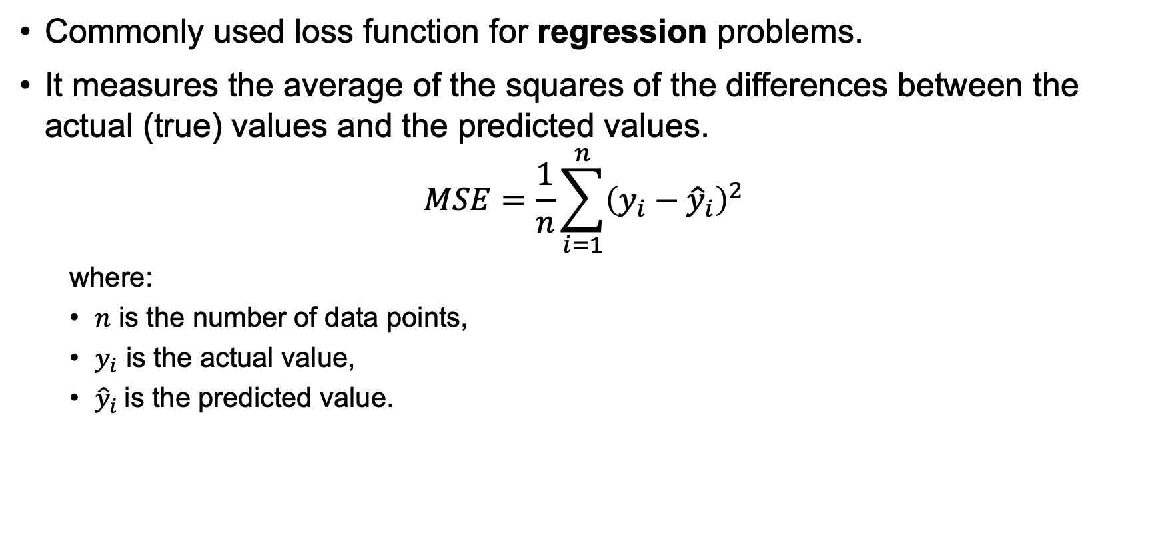
Mean Squared Error (MSE)
Commonly used loss function for regression problems.
It measures the average of the squares of the differences between the actual (true) values and the predicted values.
$$MSE=\frac{1}{n}\sum_{i=1}^{n}{{\left(y_{i}−{\hat{y}}_{i}\right)}^{2}}$$
where:
$n$ is the number of data points,
$y_{i}$ is the actual value,
${\hat{y}}_{i}$is the predicted value.

Slide 33
MSE (Key characteristics)
Squaring the Errors: By squaring the differences, MSE penalizes larger errors more heavily than smaller ones. This makes MSE highly sensitive to outliers.
Units: The output unit of MSE is the square of the unit of the target variable. For example, if the target is measured in dollars, the MSE is in dollars squared.
Differentiability: MSE is a differentiable function, which makes it suitable for optimization using gradient-based methods such as stochastic gradient descent (SGD).
Convexity: For linear models, the MSE loss surface is convex, ensuring that gradient descent converges to a global minimum.

Slide 34
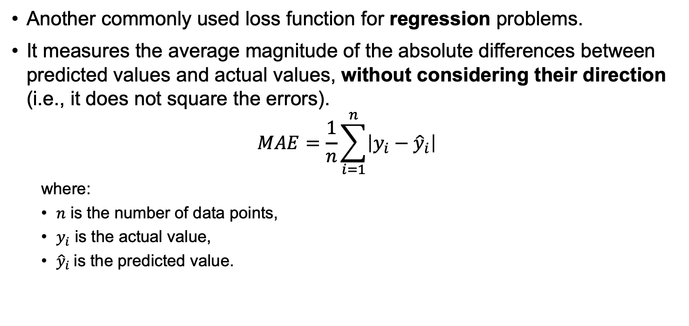
Mean Average Error (MAE)
Another commonly used loss function for regression problems.
It measures the average magnitude of the absolute differences between predicted values and actual values, without considering their direction (i.e., it does not square the errors).
$$MAE=\frac{1}{n}\sum_{i=1}^{n}{\left|y_{i}−{\hat{y}}_{i}\right|}$$
where:
$n$ is the number of data points,
$y_{i}$ is the actual value,
${\hat{y}}_{i}$is the predicted value.

Slide 35
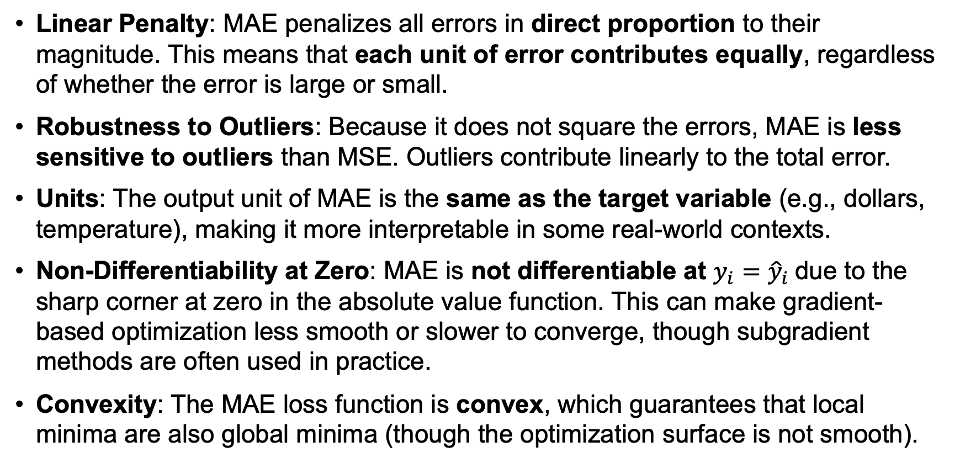
MAE (Key characteristics)
Linear Penalty: MAE penalizes all errors in direct proportion to their magnitude. This means that each unit of error contributes equally, regardless of whether the error is large or small.
Robustness to Outliers: Because it does not square the errors, MAE is less sensitive to outliers than MSE. Outliers contribute linearly to the total error.
Units: The output unit of MAE is the same as the target variable (e.g., dollars, temperature), making it more interpretable in some real-world contexts.
Non-Differentiability at Zero: MAE is not differentiable at​ $y_{i}={\hat{y}}_{i}$due to the sharp corner at zero in the absolute value function. This can make gradient-based optimization less smooth or slower to converge, though subgradient methods are often used in practice.
Convexity: The MAE loss function is convex, which guarantees that local minima are also global minima (though the optimization surface is not smooth).

Slide 36

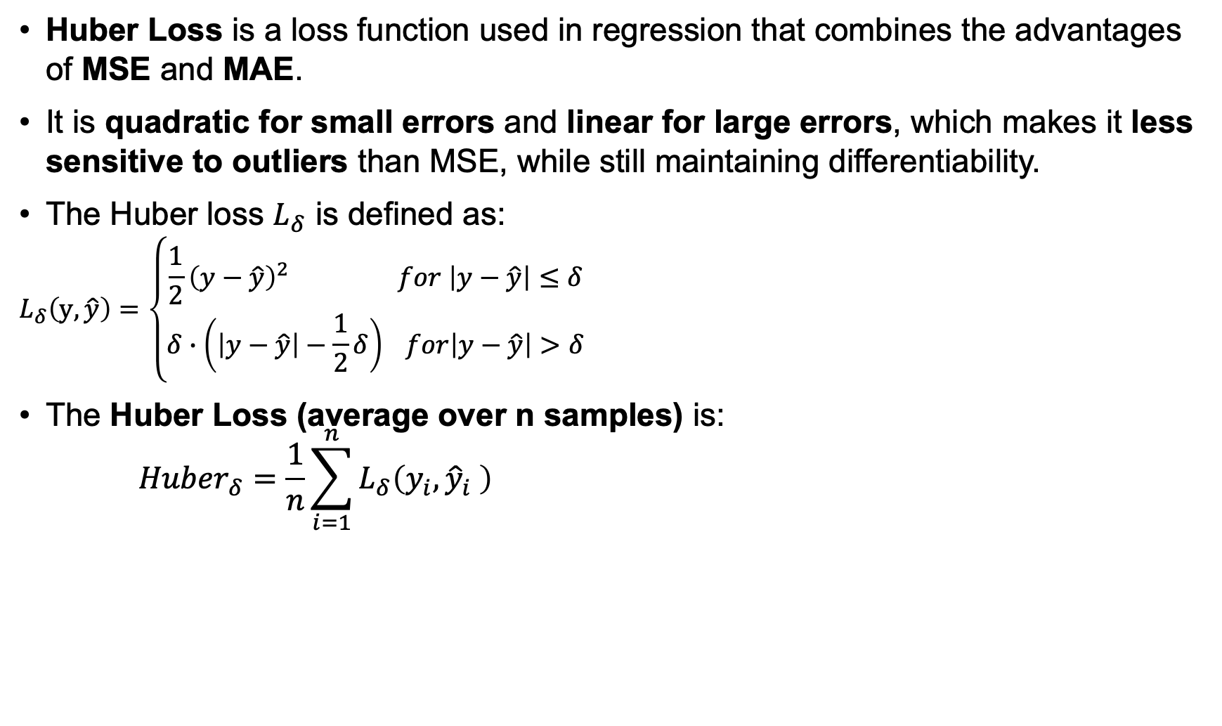
Huber Loss
Huber Loss is a loss function used in regression that combines the advantages of MSE and MAE.
It is quadratic for small errors and linear for large errors, which makes it less sensitive to outliers than MSE, while still maintaining differentiability.
The Huber loss $L_{δ}$ is defined as:
$$L_{δ}\left(y,\hat{y}\right)=\left\{\begin{aligned}\frac{1}{2}{\left(y−\hat{y}\right)}^{2} for \left|y−\hat{y}\right|≤δ \\ δ∙\left(\left|y−\hat{y}\right|−\frac{1}{2}δ\right) for\left|y−\hat{y}\right|>δ\end{aligned}\right.$$
The Huber Loss (average over n samples) is:
$${Huber}_{δ}=\frac{1}{n}\sum_{i=1}^{n}{L_{δ}\left(y_{i},{\hat{y}}_{i} \right)}$$
where:
$y$ is the true value;
$\hat{y}$ is the predicted value;
$δ$ is a hyperparameter that controls the threshold between the quadratic and linear behavior.

Slide 37
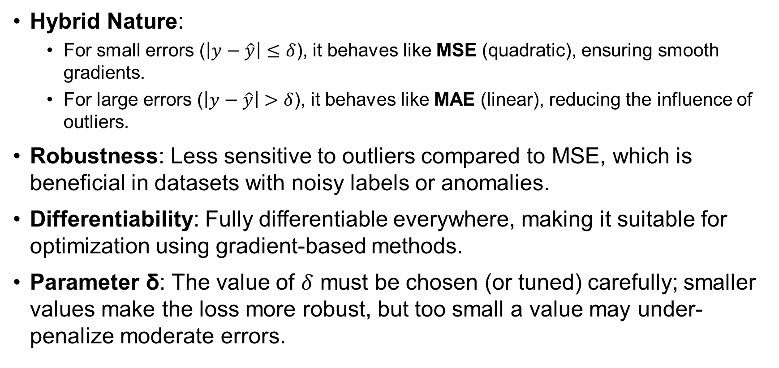
Huber Loss (Key Characteristics)
Hybrid Nature:
For small errors ($\left|y−\hat{y}\right|≤δ$), it behaves like MSE (quadratic), ensuring smooth gradients.
For large errors ($\left|y−\hat{y}\right|>δ$), it behaves like MAE (linear), reducing the influence of outliers.
Robustness: Less sensitive to outliers compared to MSE, which is beneficial in datasets with noisy labels or anomalies.
Differentiability: Fully differentiable everywhere, making it suitable for optimization using gradient-based methods.
Parameter δ: The value of $δ$ must be chosen (or tuned) carefully; smaller values make the loss more robust, but too small a value may under-penalize moderate errors.

Slide 38
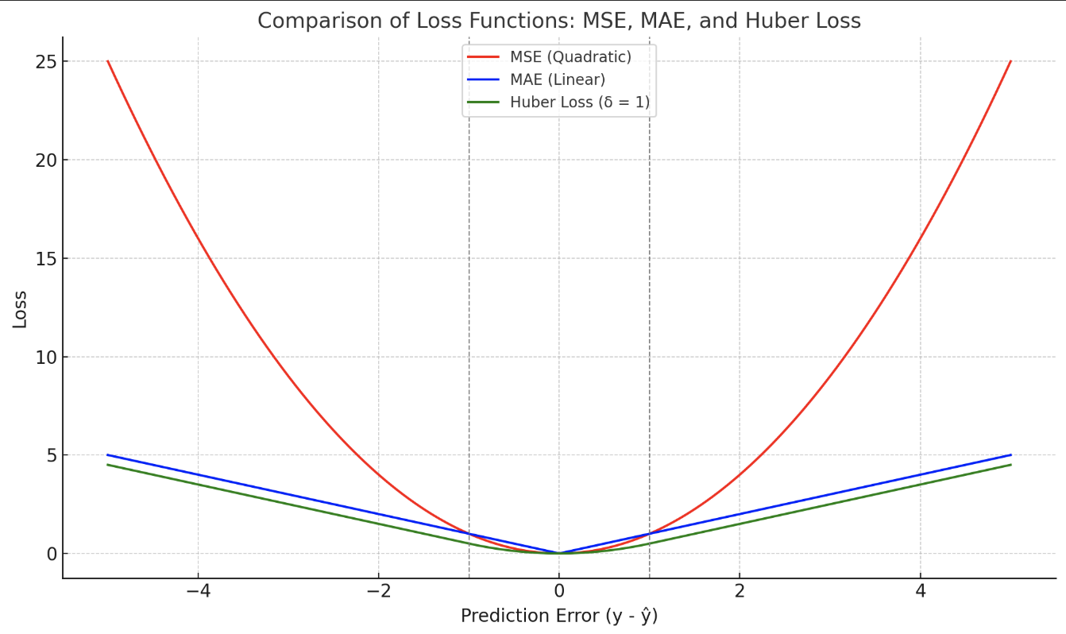
Comparison
MSE (red curve): Quadratic growth; penalizes large errors heavily.
MAE (blue curve): Linear growth; treats all errors equally regardless of size.
Huber Loss (green curve): Quadratic for small errors and linear beyond a threshold δ = 1; balances smooth optimization with robustness to outliers.

Slide 39
Summary Comparison
Property | MSE | MAE | Huber Loss
Error Weighting | Squared (emphasizes large errors) | Linear (equal weight to all errors) | Quadratic for small, linear for large
Sensitivity to Outliers | High | Low | Medium
Differentiable | Yes | Not at zero | Yes
Unit of Output | Squared unit of target | Same as target | Depends on regime (quadratic/linear)
Use Case | Smooth optimization, no outliers | Outlier-resistant tasks | Balance between MSE and MAE

Slide 40
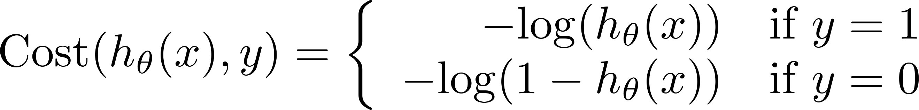
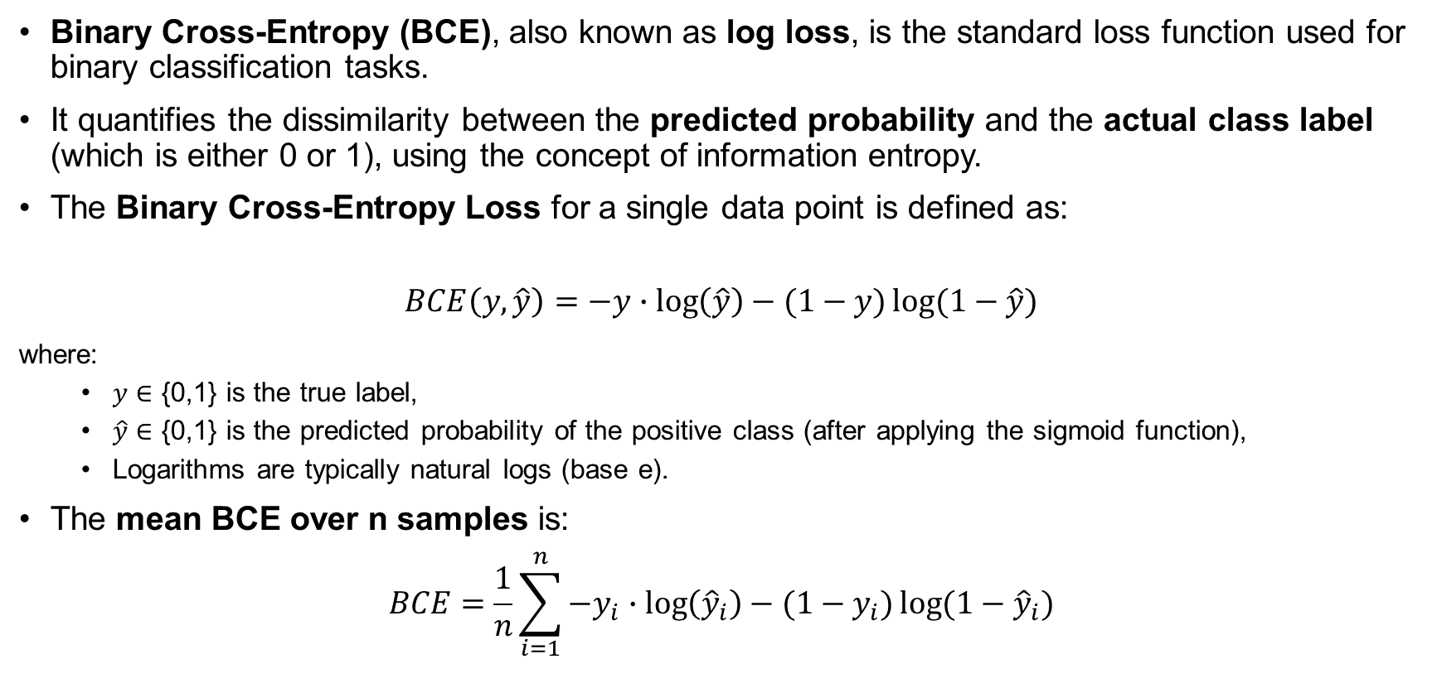
Binary Cross Entropy (BCE)
Binary Cross-Entropy (BCE), also known as log loss, is the standard loss function used for binary classification tasks.
It quantifies the dissimilarity between the predicted probability and the actual class label (which is either 0 or 1), using the concept of information entropy.
The Binary Cross-Entropy Loss for a single data point is defined as:
$$BCE\left(y,\hat{y}\right)=−y∙\log\left(\hat{y}\right)−(1−y)\log{(1−\hat{y})}$$
where:
$y$ ∈ {0,1} is the true label,
$\hat{y}$ ∈ {0,1} is the predicted probability of the positive class (after applying the sigmoid function),
Logarithms are typically natural logs (base e).
The mean BCE over n samples is:
$$BCE=\frac{1}{n}\sum_{i=1}^{n}{−y_{i}∙\log\left({\hat{y}}_{i}\right)−(1−y_{i})\log{(1−{\hat{y}}_{i})}}$$

Slide 41
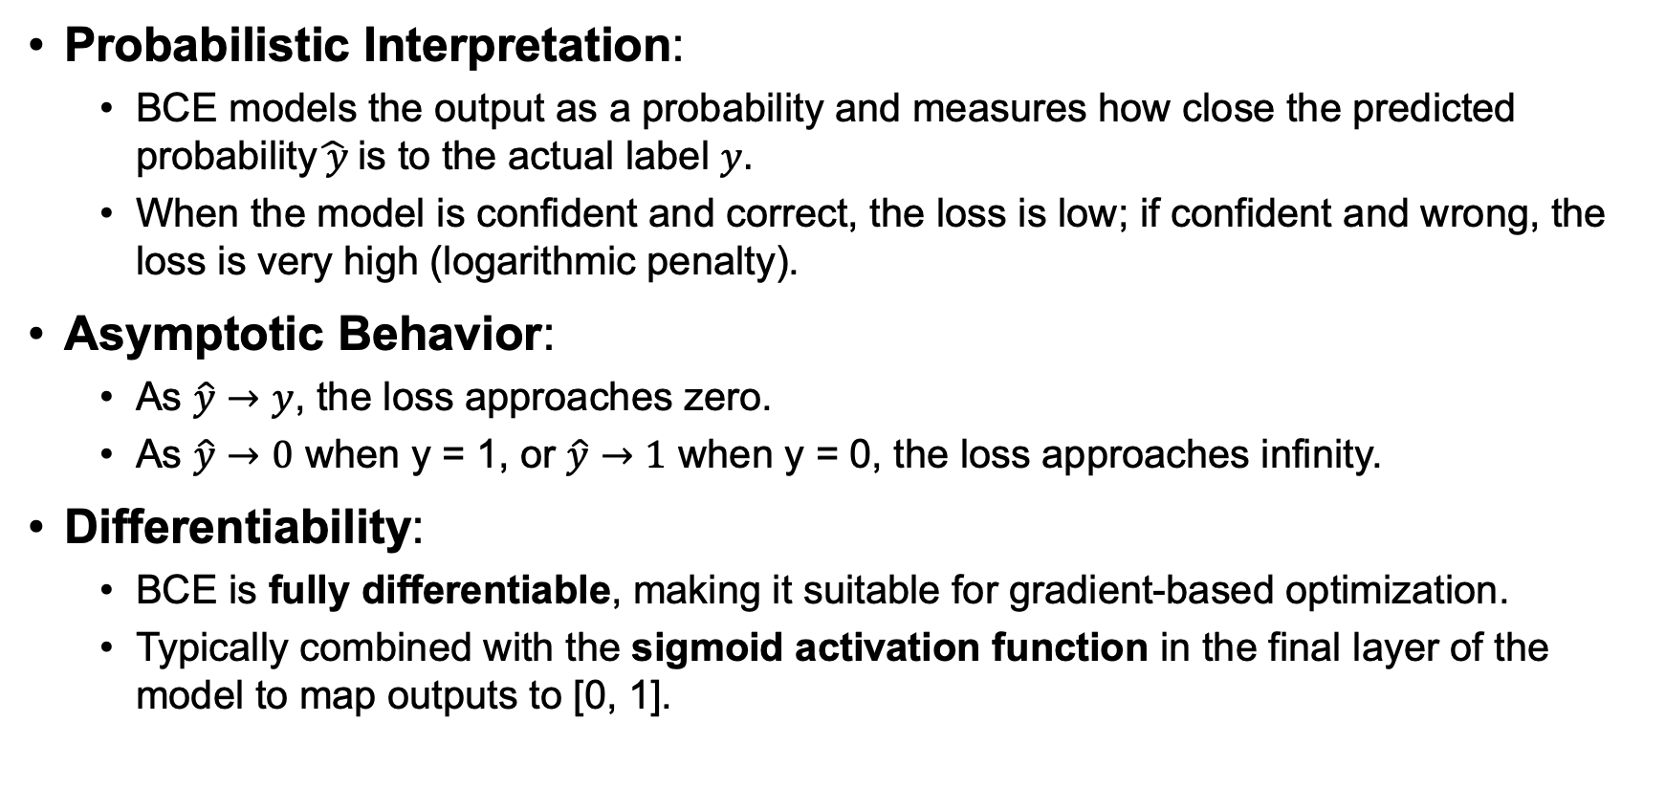
BCE (Key characteristics)
Probabilistic Interpretation:
BCE models the output as a probability and measures how close the predicted probability$\hat{ y}$is to the actual label $y.$
When the model is confident and correct, the loss is low; if confident and wrong, the loss is very high (logarithmic penalty).
Asymptotic Behavior:
As $\hat{y}→y$, the loss approaches zero.
As $\hat{y}→0$ when y = 1, or $\hat{y}→1$ when y = 0, the loss approaches infinity.
Differentiability:
BCE is fully differentiable, making it suitable for gradient-based optimization.
Typically combined with the sigmoid activation function in the final layer of the model to map outputs to [0, 1].

Slide 42
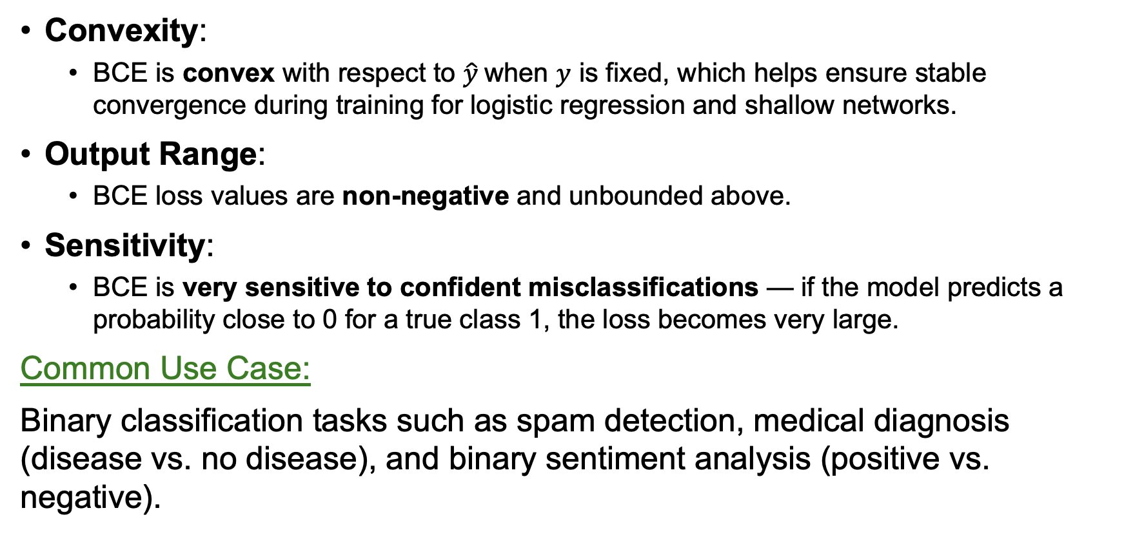
BCE (Key characteristics) contd.
Convexity:
BCE is convex with respect to $\hat{y}$when $y$ is fixed, which helps ensure stable convergence during training for logistic regression and shallow networks.
Output Range:
BCE loss values are non-negative and unbounded above.
Sensitivity:
BCE is very sensitive to confident misclassifications — if the model predicts a probability close to 0 for a true class 1, the loss becomes very large.
Common Use Case:
Binary classification tasks such as spam detection, medical diagnosis (disease vs. no disease), and binary sentiment analysis (positive vs. negative).

Slide 43
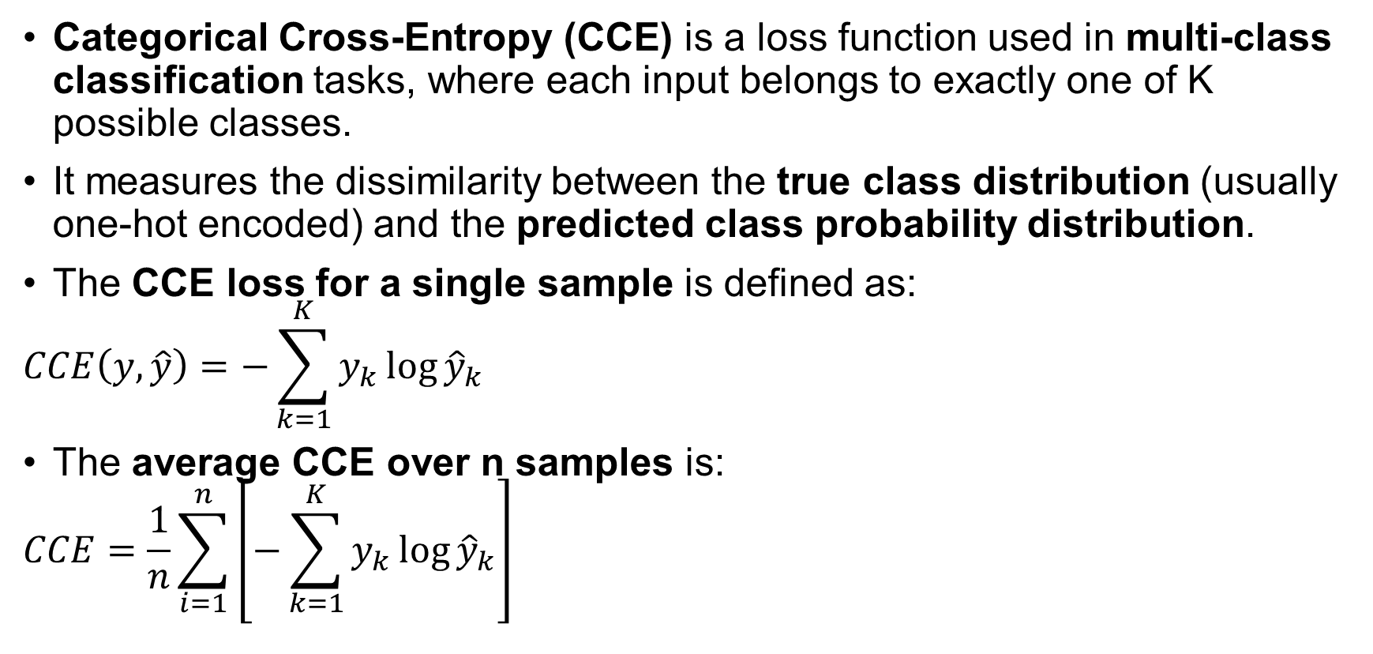
Categorical Cross Entropy (CCE)
Categorical Cross-Entropy (CCE) is a loss function used in multi-class classification tasks, where each input belongs to exactly one of K possible classes.
It measures the dissimilarity between the true class distribution (usually one-hot encoded) and the predicted class probability distribution.
The CCE loss for a single sample is defined as:
$$CCE\left(y,\hat{y}\right)=−\sum_{k=1}^{K}{y_{k}\log{{\hat{y}}_{k}}}$$
The average CCE over n samples is:
$$CCE=\frac{1}{n}\sum_{i=1}^{n}{\left[−\sum_{k=1}^{K}{y_{k}\log{{\hat{y}}_{k}}}\right]}$$
Where:
K is the number of classes,
y_{k}​∈{0,1} is the indicator for the true class (i.e., 1 for the correct class, 0 otherwise),

Slide 44
Gradient Descent

Slide 45
Linear Regression
Exp, x₁ | Profile, x₂ | Gender, x₃ | Salary, y
7.5 | Web | M | 2.1 L
2.5 | Android | M | 60 K
6 | ML | F | 1.8 L
8 | Web | F | 2.5 L
5 | ML | F | 80 K
Very close to neural networks
x₁
w₁
x₂
w₂
$$\hat{y}$$
w₃
4D
x₃
b
2D ➔ y = mx + b → Line
3D ➔ y = ax₁ + bx₂ + c → Plane
4D ➔ y = ax₁ + bx₂ + cx₃ + d → Hyperplane
a, b, c
d
weights
Bias (offset)

Slide 46
What Is Optimization?
Optimization is the process of adjusting the model parameters to minimize the loss function.
It’s like finding the bottom of a valley in a loss landscape — the lowest possible value of the loss based on the current weights and biases.
Imagine the loss function as a surface or curve:
The x and y axes are the weights (W) and biases (b)
The z axis is the loss value
Optimization is the process of navigating this surface to find the lowest point (minimum) — the point where the model performs best.
How Do We Minimize the Loss?
This is where optimization algorithms come in.
The most common one in neural networks is: Gradient Descent

Slide 47
Gradient Descent
Applied in:
Linear Regression, Logistic Regression, PCA, Neural Network (Backbone of DL)
Gradient Descent is an optimization algorithm used to minimize a cost function (also called the loss function) by iteratively moving in the direction of the steepest descent, i.e., the negative of the gradient.
Analogy: Hiking down a hill blindfolded
Imagine you’re standing on a hilltop, blindfolded. Your goal is to reach the lowest point in the valley.
You can’t see where to go. So, you feel the ground around you to check which direction is sloping down.
You then take a small step in that direction.
Repeat this process until you can’t go any lower – voila!! The bottom!!!

Slide 48
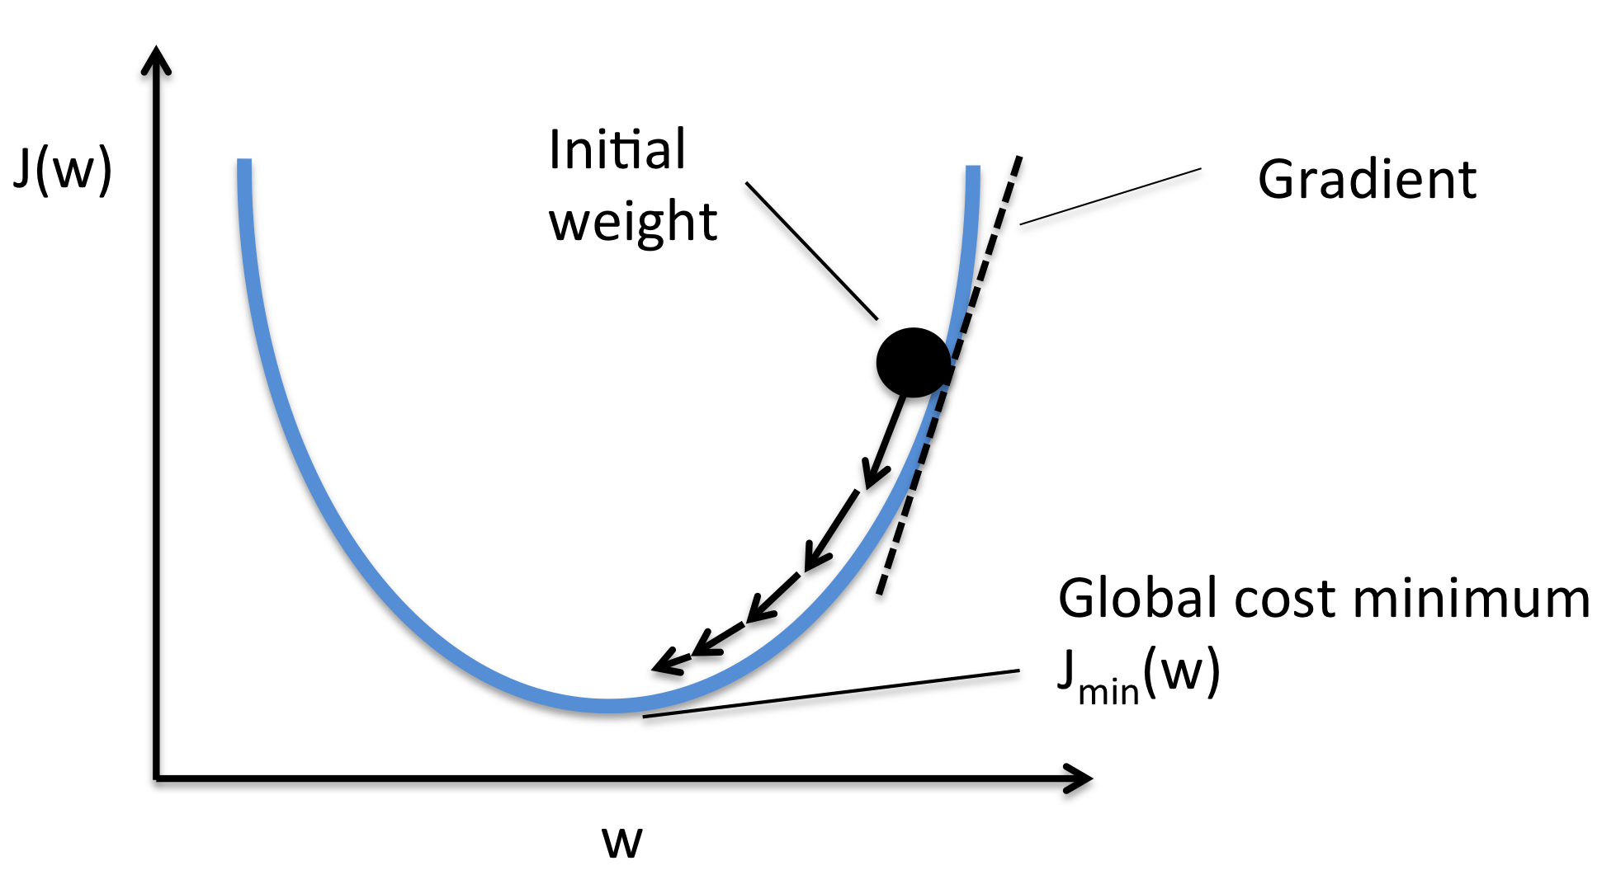
How it works: Simple terms
A model makes a prediction
It checks how wrong the prediction is (using a loss function)
Then it calculates which direction to change the parameters to reduce the error (gradient).
It takes a small step in that direction (descent).
Repeat this over and over until the error is as small as possible.

Slide 49
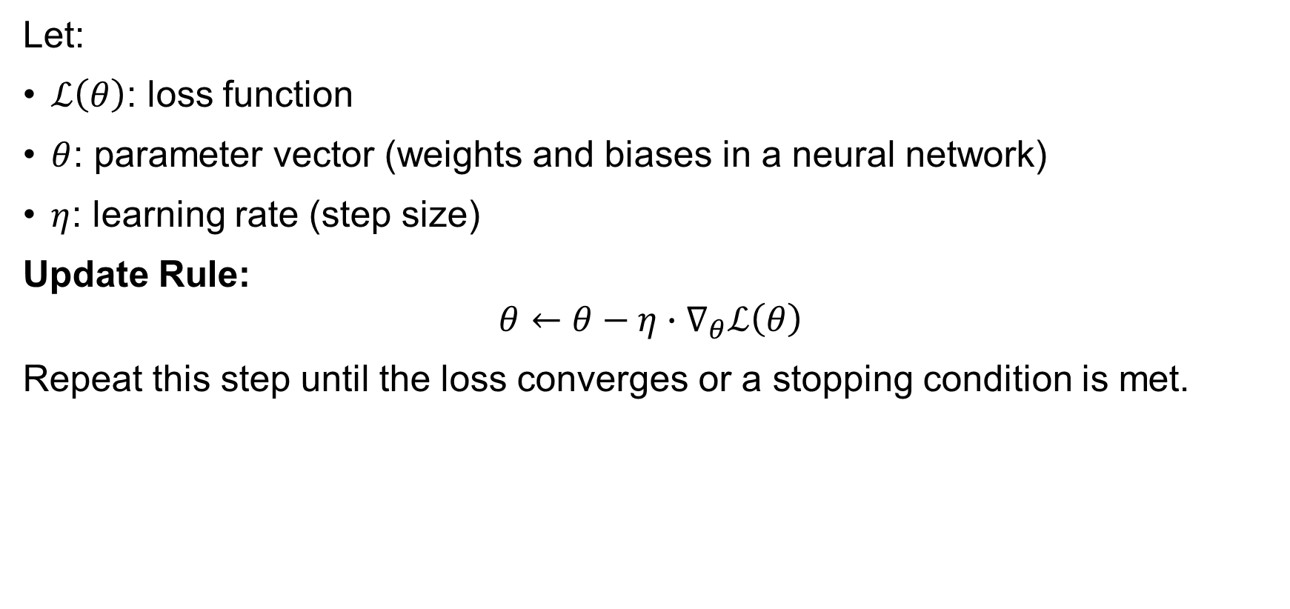
Mathematical Formulation
Let:
$ℒ\left(θ\right)$: loss function
$θ$: parameter vector (weights and biases in a neural network)
$η$: learning rate (step size)
Update Rule:
$$θ←θ−η∙∇_{θ}ℒ\left(θ\right)$$
Repeat this step until the loss converges or a stopping condition is met.

Slide 50
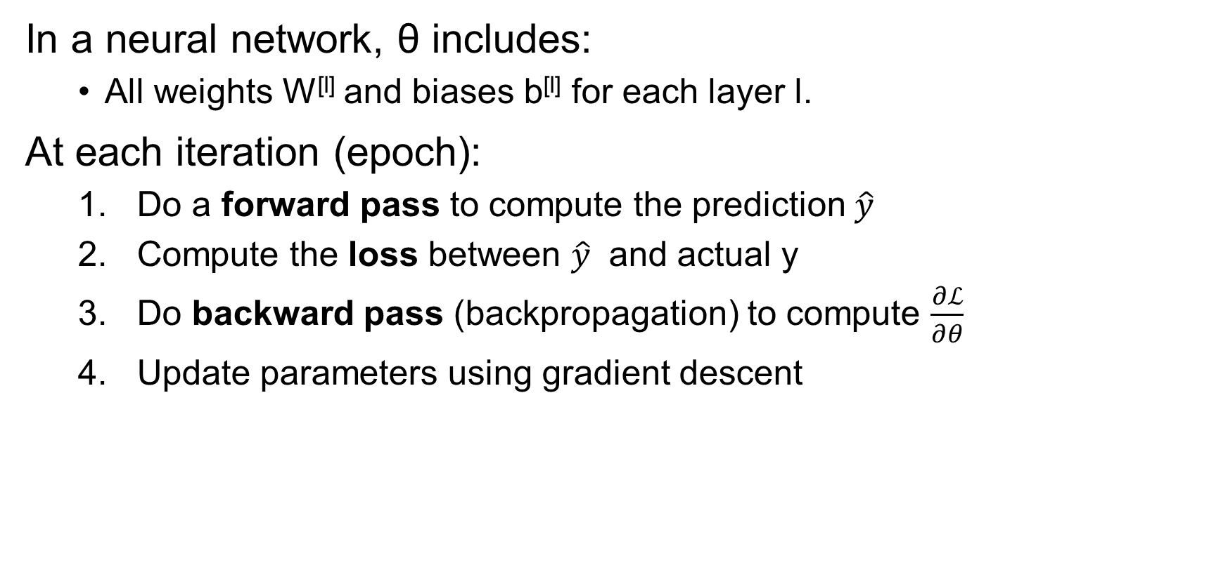
How Gradient Descent Works in Neural Networks
In a neural network, θ includes:
All weights W^{[l]} and biases b^{[l]} for each layer l.
At each iteration (epoch):
Do a forward pass to compute the prediction $\hat{y}$
Compute the loss between $\hat{y}$​ and actual y
Do backward pass (backpropagation) to compute $\frac{∂ℒ}{∂θ}$
Update parameters using gradient descent

Slide 51
Variants of Gradient Descent
The key difference in gradient descent variants lies in how much data is used to compute the gradient at each step.
Batch Gradient Descent (Vanilla Gradient Descent)
Stochastic Gradient Descent (SGD)
Mini-Batch Gradient Descent (Most Common in Practice)

Slide 52
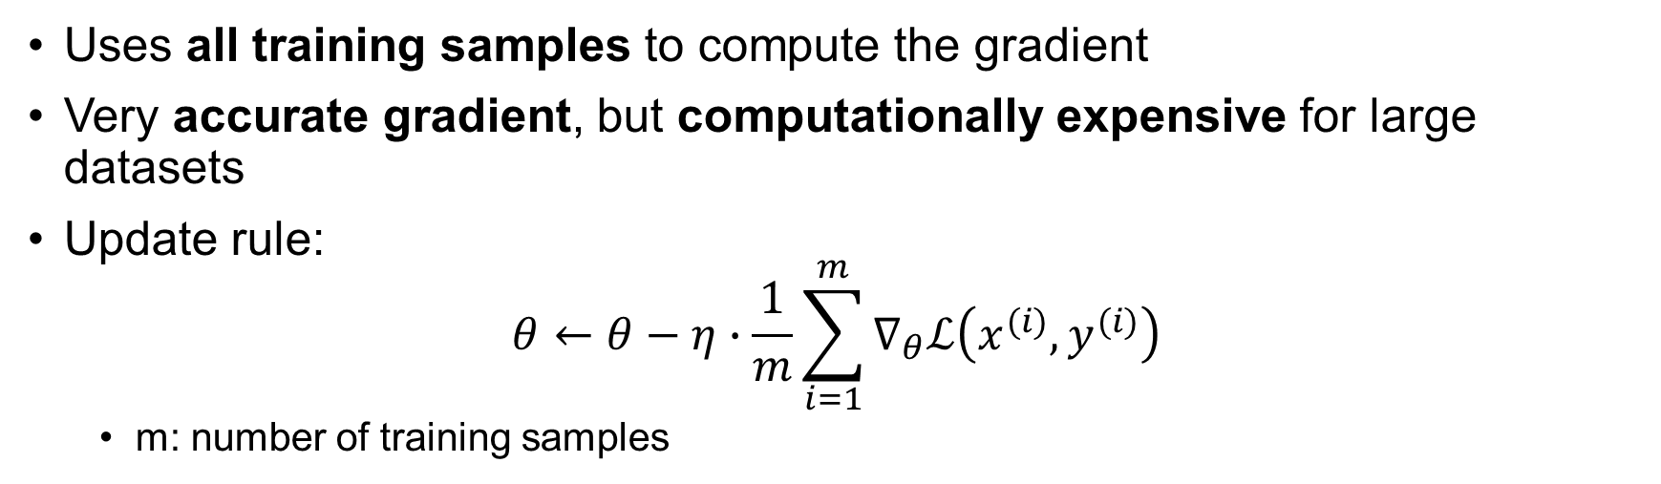
1. Batch Gradient Descent (Vanilla GD)
Uses all training samples to compute the gradient
Very accurate gradient, but computationally expensive for large datasets
Update rule:
$$θ←θ−η∙\frac{1}{m}\sum_{i=1}^{m}{∇_{θ}ℒ\left(x^{(i)},y^{(i)}\right)}$$
m: number of training samples
Pros:
Stable convergence
Fewer oscillations
Cons:
Slow for large datasets
Memory intensive

Slide 53

2. Stochastic Gradient Descent (SGD)
Uses one training example per update
Fast, but noisy estimates of the gradient
Update rule:
$$θ←θ−η∙∇_{θ}ℒ\left(x^{(i)},y^{(i)}\right)$$
Pros:
Very fast
Can escape local minima due to noise
Cons:
High variance in updates
May not converge smoothly

Slide 54
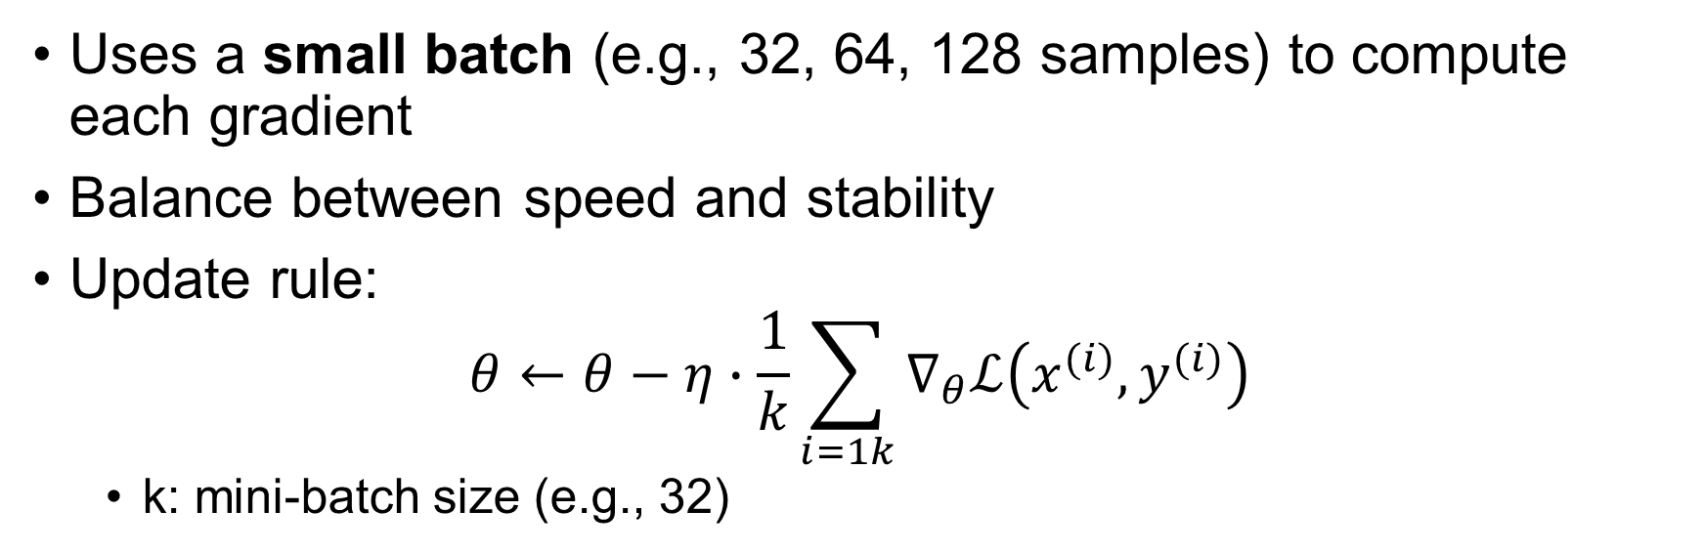
3. Mini-Batch Gradient Descent
Uses a small batch (e.g., 32, 64, 128 samples) to compute each gradient
Balance between speed and stability
Update rule:
$$θ←θ−η∙\frac{1}{k}\sum_{i=1k}{∇_{θ}ℒ\left(x^{(i)},y^{(i)}\right)}$$
k: mini-batch size (e.g., 32)
Pros:
Fast and efficient
Parallelizable
Smooth convergence
Cons:
Still a bit noisy
Needs tuning of batch size

Slide 55
Choosing the Learning Rate (η)
This is a hyperparameter.
Too small: Convergence is slow
Too large: May overshoot or diverge
Use learning rate schedulers to adjust over time

Slide 56
Advanced Optimizers (Beyond Basic GD)
While not strictly "variations" of gradient descent, these are improvements based on GD:
Optimizer | Key Feature
Momentum | Accelerates GD by adding velocity
RMSProp | Adapts learning rate per parameter
Adam | Combines momentum and RMSProp
Adagrad | Increases learning rate for infrequent parameters

Slide 57
Additional Concepts
Epoch vs Iteration:
Epoch = 1 pass through full dataset
Iteration = 1 update step (i.e., per batch or mini-batch)
b) Loss Landscape:
The shape of the cost function affects how gradients behave
Flat areas → slow learning; steep areas → possible instability
c) Convergence Criteria:
Early stopping (based on validation loss)
Max number of epochs
Gradient norm approaching zero

Slide 58
Summary
Variant | Data Used | Speed | Stability | Use Case
Batch GD | All data | Slow | Stable | Small datasets
Stochastic GD | One sample | Fast | Unstable | Online learning
Mini-batch GD | Small batch | Balanced | Balanced | Deep learning (✅)

Slide 59
Backpropagation: A complete guide

Slide 60
The “What”? - Understanding backpropagation
Short for “backward propagation of error”.
The derivation of the backpropagation algorithm as used and understood in a modern machine learning context was first published by David E. Rumelhart, Geoffrey Hinton and Ronald J. Williams in their 1986 paper, “Learning representations by back-propagating errors”.[2]
Backpropagation is a machine learning technique essential to the optimization of artificial neural networks. It facilitates the use of gradient descent algorithms to update network weights, which is how the deep learning models driving modern artificial intelligence (AI) “learn.” [3]
Prerequisites for Understanding Backpropagation:
Gradient Descent: An optimization algorithm
Forward Propagation: A technique for neural network predictions

Slide 61






Purpose of Backpropagation Algorithm
An algorithm used to train Neural Networks
Example:
CGPA | IQ | Package (Lakh)
7.1 | 83 | 3.2
8.5 | 91 | 4.5
6.3 | 102 | 6.1
5.1 | 87 | 2.7
$$w_{11}^{1}$$
CGPA
b₁₁
$$w_{21}^{1}$$
$$w_{12}^{2}$$
$$w_{12}^{1}$$
b₂₁
$${\hat{y}}_{i}$$
IQ
b₁₂
$$w_{22}^{2}$$
$$w_{22}^{1}$$
To find the optimum values for weights and biases for a given dataset, enabling the neural network to make the best predictions

Slide 62

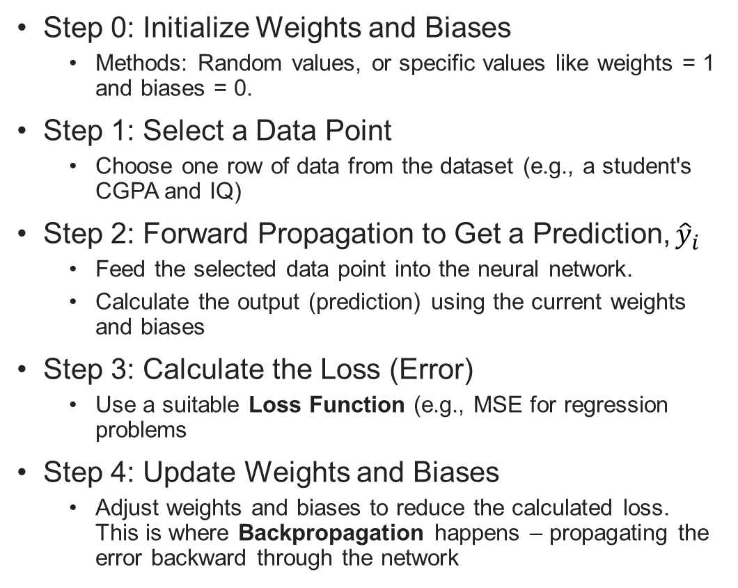
The Backpropagation Algorithm: A Series of Steps
CGPA | IQ | Package (Lakh)
7.1 | 83 | 3.2
8.5 | 91 | 4.5
6.3 | 102 | 6.1
5.1 | 87 | 2.7
Step 0: Initialize Weights and Biases
Methods: Random values, or specific values like weights = 1 and biases = 0.
Step 1: Select a Data Point
Choose one row of data from the dataset (e.g., a student's CGPA and IQ)
Step 2: Forward Propagation to Get a Prediction, ${\hat{y}}_{i}$
Feed the selected data point into the neural network.
Calculate the output (prediction) using the current weights and biases
Step 3: Calculate the Loss (Error)
Use a suitable Loss Function (e.g., MSE for regression problems
Step 4: Update Weights and Biases
Adjust weights and biases to reduce the calculated loss. This is where Backpropagation happens – propagating the error backward through the network
$$w_{11}^{1}$$
b₁₁
CGPA
$$w_{21}^{1}$$
$$w_{12}^{2}$$
$$w_{12}^{1}$$
b₂₁
$${\hat{y}}_{i}$$
IQ
b₁₂
$$w_{22}^{2}$$
$$w_{22}^{1}$$

Slide 63


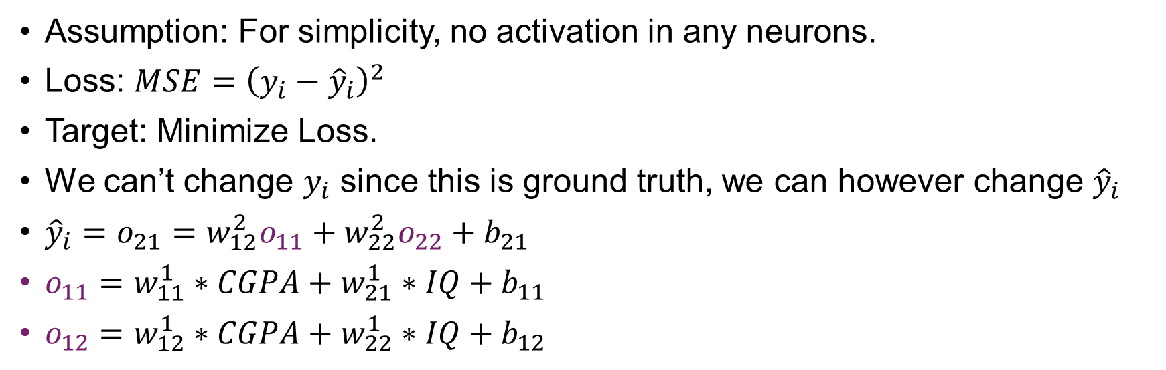

Backpropagation Example: Regression
CGPA | IQ | Package (Lakh)
7.1 | 83 | 3.2
8.5 | 91 | 4.5
$$w_{11}^{1}$$
o₁₁
CGPA
b₁₁
$$w_{21}^{1}$$
$$w_{12}^{2}$$
b₂₁
o₂₁
$$w_{12}^{1}$$
o₁₂
$${\hat{y}}_{i}$$
IQ
b₁₂
$$w_{22}^{2}$$
$$w_{22}^{1}$$
Assumption: For simplicity, no activation in any neurons.
Loss: $MSE={\left(y_{i}−{\hat{y}}_{i}\right)}^{2}$
Target: Minimize Loss.
We can’t change $y_{i}$ since this is ground truth, we can however change ${\hat{y}}_{i}$
${\hat{y}}_{i}=o_{21}=w_{12}^{2}o_{11}+w_{22}^{2}o_{22}+b_{21}$
$o_{11}=w_{11}^{1}∗CGPA+w_{21}^{1}∗IQ+b_{11}$
$o_{12}=w_{12}^{1}∗CGPA+w_{22}^{1}∗IQ+b_{12}$

Slide 64
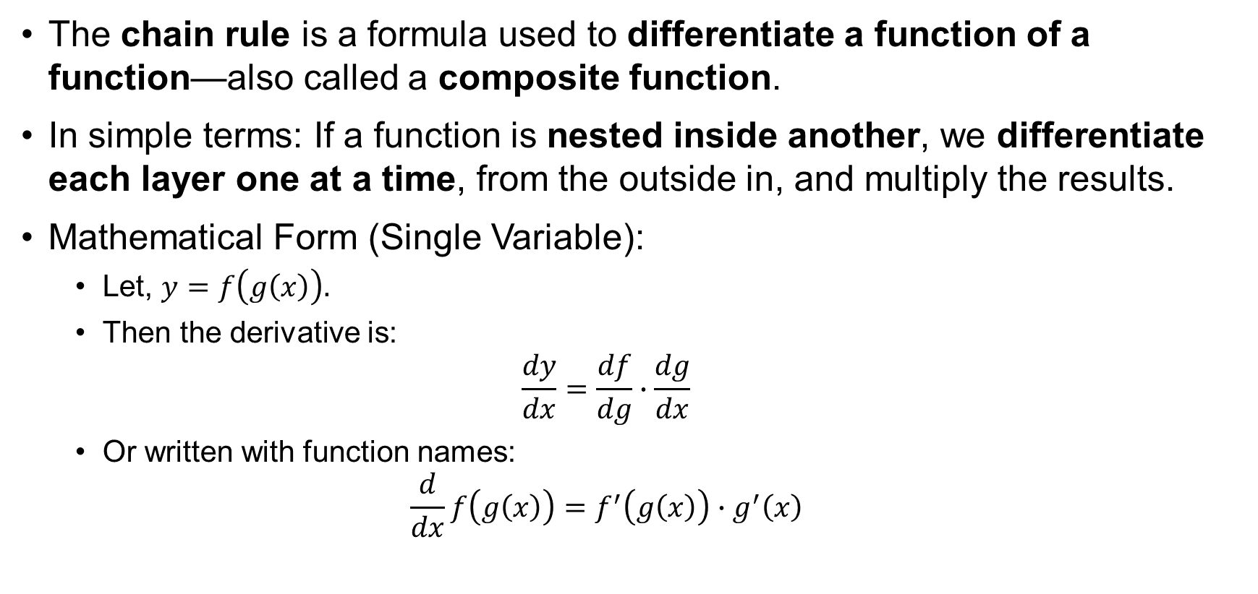
Recap: Chain Rule of Differentiation
The chain rule is a formula used to differentiate a function of a function—also called a composite function.
In simple terms: If a function is nested inside another, we differentiate each layer one at a time, from the outside in, and multiply the results.
Mathematical Form (Single Variable):
Let, $y=f\left(g\left(x\right)\right).$
Then the derivative is:
$$\frac{dy}{dx}=\frac{df}{dg}∙\frac{dg}{dx}$$
Or written with function names:
$$\frac{d}{dx}f\left(g\left(x\right)\right)=f^{′}\left(g\left(x\right)\right)∙g^{′}\left(x\right)$$

Slide 65
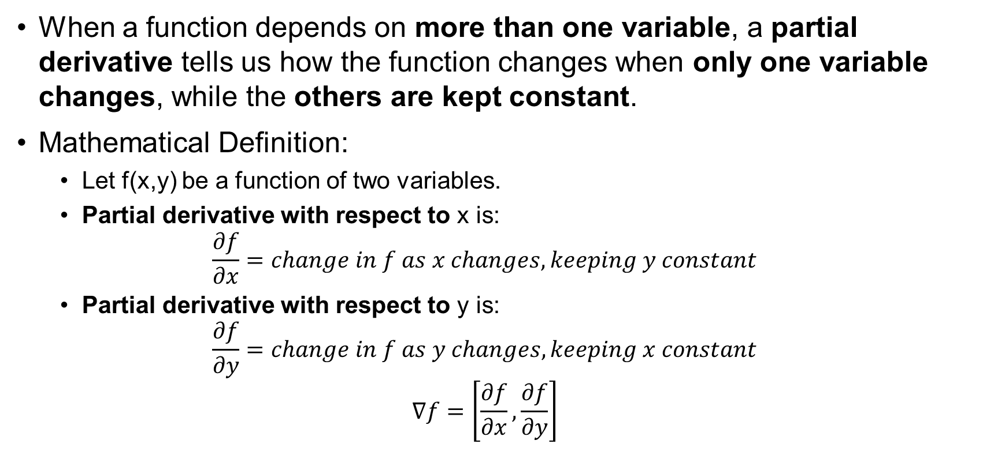
Recap: Partial Derivatives
When a function depends on more than one variable, a partial derivative tells us how the function changes when only one variable changes, while the others are kept constant.
Mathematical Definition:
Let f(x,y) be a function of two variables.
Partial derivative with respect to x is:
$$\frac{∂f}{∂x}=change in f as x changes, keeping y constant$$
Partial derivative with respect to y is:
$$\frac{∂f}{∂y}=change in f as y changes, keeping x constant$$
$$∇f=\left[\frac{∂f}{∂x},\frac{∂f}{∂y}\right]$$

Slide 66

Recap: Gradient Descent Update Rule
Weights and bias update:
$$w_{new}=w_{old}−η\frac{∂L}{∂w_{old}}$$
$$b_{new}=b_{old}−η\frac{∂L}{∂b_{old}}$$
This rule is applied for all trainable parameters (weights and biases)

Slide 67
Calculation of Derivatives: Output Layer

Slide 68
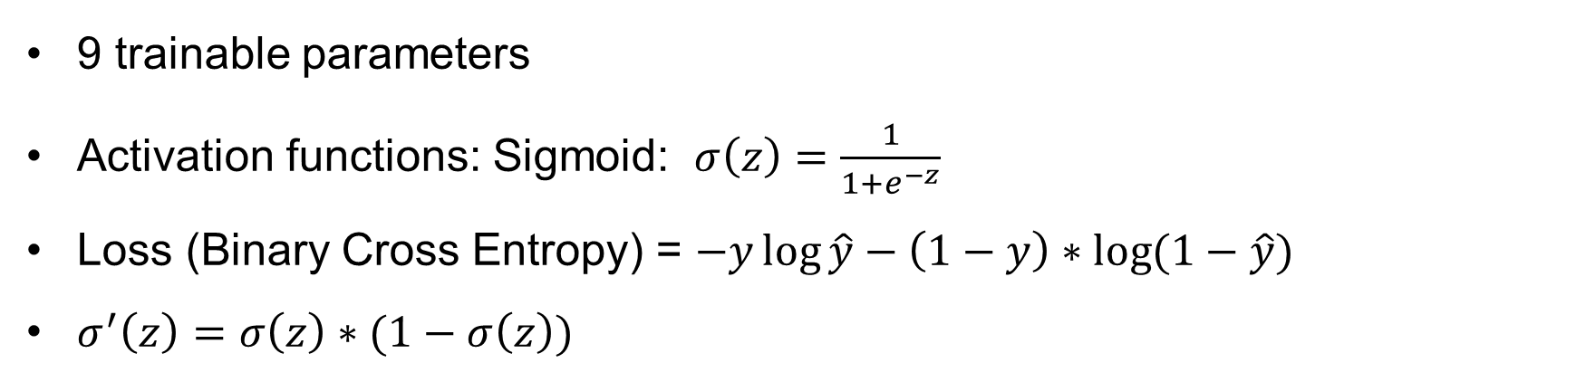
Backpropagation Example: Classification
CGPA | IQ | Placement
8 | 83 | 1
7 | 91 | 1
6 | 100 | 0
5 | 59 | 0
$$w_{11}^{1}$$
CGPA
b₁₁
$$w_{21}^{1}$$
$$w_{12}^{2}$$
$$w_{12}^{1}$$
b₂₁
$${\hat{y}}_{i}$$
IQ
b₁₂
$$w_{22}^{2}$$
$$w_{22}^{1}$$
9 trainable parameters
Activation functions: Sigmoid: $σ\left(z\right)=\frac{1}{1+e^{−z}}$
Loss (Binary Cross Entropy) = $−y\log{\hat{y}}−\left(1−y\right)∗\log{(1−\hat{y})}$
$σ^{′}\left(z\right)=σ\left(z\right)∗(1−σ\left(z\right))$

Slide 69








Calculation of Derivatives: Output Layer
Let’s assume:
The output layer is: $\hat{y}=σ(z)$
The loss is BCE applied to $\hat{y}$.
Using the chain rule:
$$\frac{∂L}{∂z}=\frac{∂L}{∂\hat{y}}∙\frac{∂\hat{y}}{∂z}$$
Recall:
$$\frac{∂\hat{y}}{∂z}=\frac{∂}{∂z}σ\left(z\right)=σ\left(z\right)∗\left(1−σ\left(z\right)\right)=\hat{y}(1−\hat{y})$$
$$\frac{∂L}{∂\hat{y}}=\left(−\frac{y}{\hat{y}}+\frac{1−y}{1−\hat{y}}\right)$$
Which simplifies to:
$$\frac{∂L}{∂z}=\hat{y}−y$$
$$w_{11}^{1}$$
b₁₁
CGPA
$$w_{21}^{1}$$
$$w_{12}^{2}$$
$$w_{12}^{1}$$
b₂₁
$${\hat{y}}_{i}$$
IQ
b₁₂
$$w_{22}^{2}$$
$$w_{22}^{1}$$

Slide 70
Intermediate Value Caching

Slide 71
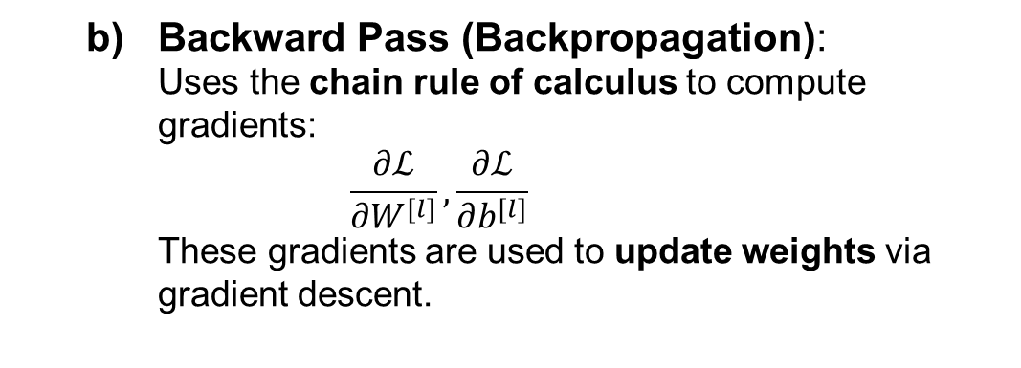
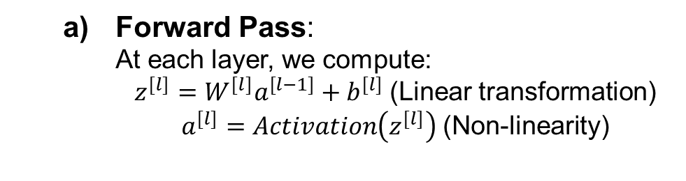
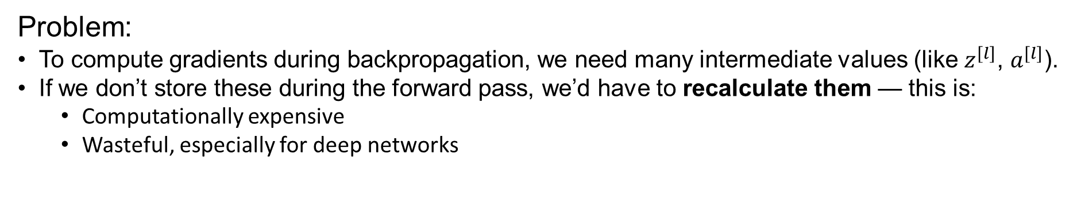
Why Is Intermediate Value Caching Necessary?
Training an artificial neural network (a.k.a. MLP) involves two computationally expensive processes:
Forward Pass:
At each layer, we compute:
$z^{[l]}=W^{[l]}a^{[l−1]}+b^{[l]}$ (Linear transformation)
$a^{[l]}=Activation\left(z^{[l]}\right)$ (Non-linearity)
Backward Pass (Backpropagation):
Uses the chain rule of calculus to compute gradients:
$$\frac{∂ℒ}{∂W^{[l]}}, \frac{∂ℒ}{∂b^{[l]}}$$
These gradients are used to update weights via gradient descent.
Problem:
To compute gradients during backpropagation, we need many intermediate values (like $z^{[l]}$, $a^{[l]}$).
If we don’t store these during the forward pass, we’d have to recalculate them — this is:
Computationally expensive
Wasteful, especially for deep networks
Solution: Cache intermediate values during forward pass.

Slide 72
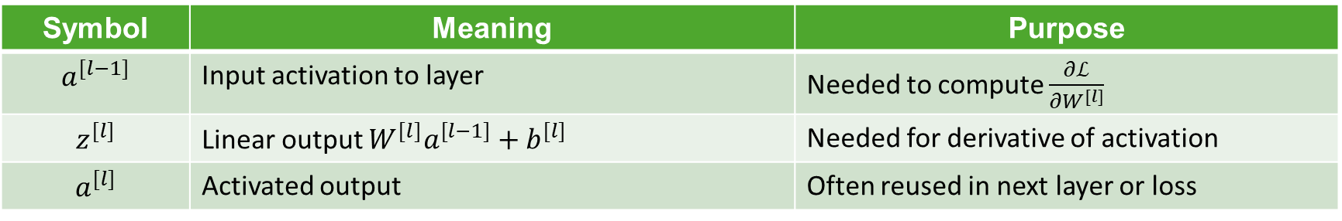
What Is Intermediate Value Caching?
Intermediate value caching is the process of storing intermediate computations (like linear outputs and activations) during the forward pass, so they can be reused during the backward pass without re-computation.
What Is Cached?
During the forward pass, for each layer l , we typically cache:
In frameworks like PyTorch and TensorFlow, this caching happens automatically using a computation graph or gradient tape.
Symbol | Meaning | Purpose
$$a^{[l−1]}$$ | Input activation to layer | Needed to compute $\frac{∂ℒ}{∂W^{[l]}}$
$$z^{[l]}$$ | Linear output $W^{[l]}a^{[l−1]}+b^{[l]}$ | Needed for derivative of activation
$$a^{[l]}$$ | Activated output | Often reused in next layer or loss

Slide 73
Vanishing/Exploding Gradient

Slide 74
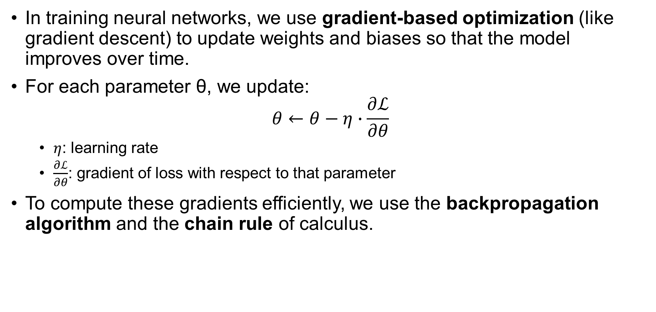
Motivation: Why Gradients Matter
In training neural networks, we use gradient-based optimization (like gradient descent) to update weights and biases so that the model improves over time.
For each parameter θ, we update:
$$θ←θ−η∙\frac{∂ℒ}{∂θ}$$
$η$: learning rate
$\frac{∂ℒ}{∂θ}$: gradient of loss with respect to that parameter
To compute these gradients efficiently, we use the backpropagation algorithm and the chain rule of calculus.

Slide 75
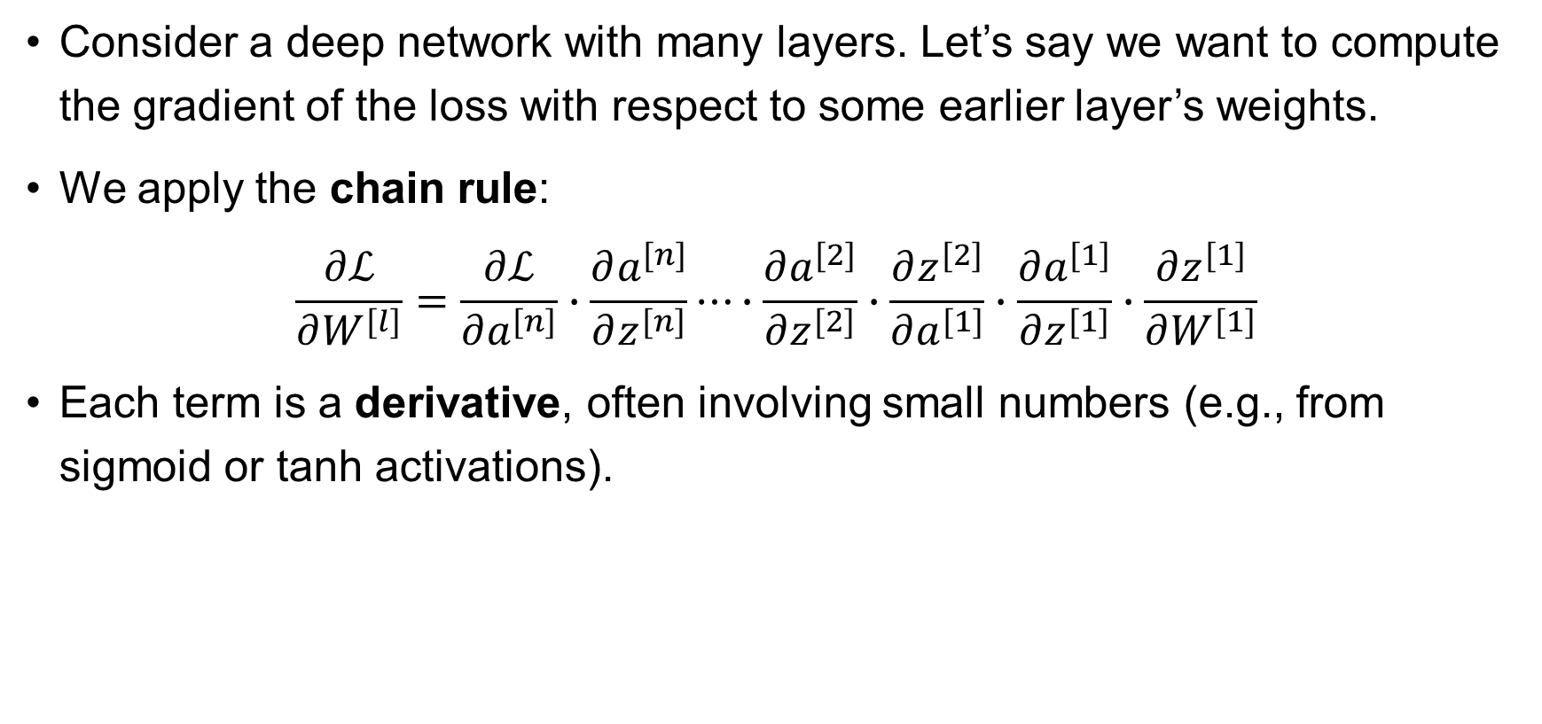
The Chain Rule in Backpropagation
Consider a deep network with many layers. Let’s say we want to compute the gradient of the loss with respect to some earlier layer’s weights.
We apply the chain rule:
$$\frac{∂ℒ}{∂W^{[l]}}=\frac{∂ℒ}{∂a^{[n]}}∙\frac{∂a^{[n]}}{∂z^{[n]}}⋯∙\frac{∂a^{[2]}}{∂z^{[2]}}∙\frac{∂z^{[2]}}{∂a^{[1]}}∙\frac{∂a^{[1]}}{∂z^{[1]}}∙\frac{∂z^{[1]}}{∂W^{[1]}}$$
Each term is a derivative, often involving small numbers (e.g., from sigmoid or tanh activations).

Slide 76
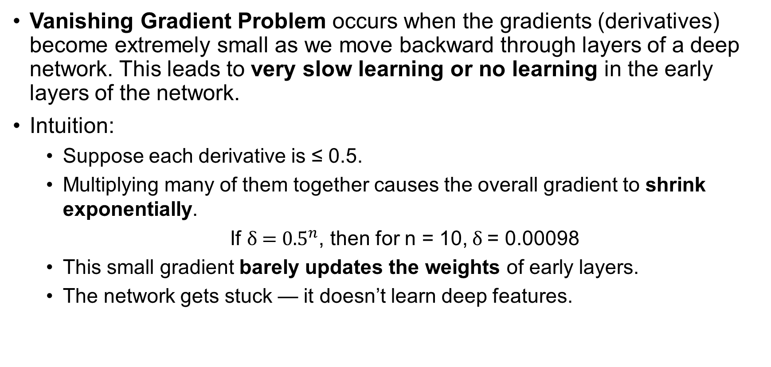
What Is the Vanishing Gradient Problem?
Vanishing Gradient Problem occurs when the gradients (derivatives) become extremely small as we move backward through layers of a deep network. This leads to very slow learning or no learning in the early layers of the network.
Intuition:
Suppose each derivative is ≤ 0.5.
Multiplying many of them together causes the overall gradient to shrink exponentially.
If $\text{δ}\text{ = }{0.5}^{n}$, then for n = 10, δ = 0.00098
This small gradient barely updates the weights of early layers.
The network gets stuck — it doesn’t learn deep features.

Slide 77
Why Does It Happen? (Root Causes)
Sigmoid or Tanh Activation Functions:
Sigmoid range: (0, 1); tanh range: (−1, 1)
Their derivatives:
Sigmoid derivative: σ′(z) = σ(z)(1−σ(z)) → max value ≈ 0.25
Tanh derivative: 1 − tanh²(z) → also < 1
So repeated multiplication of small derivatives causes the gradient to vanish.
Deep Networks:
The deeper the network, the more times small values are multiplied.
Gradient shrinks before it reaches early layers.

Slide 78
What Happens When Gradients Vanish?
Early layers barely learn (no significant weight update).
Slow convergence or no convergence.
Model performs poorly despite training for a long time.
Especially problematic in:
Deep MLPs
RNNs (Recurrent Neural Networks)

Slide 79
Solutions to Vanishing Gradient
Let’s now explore both practical solutions and architectural innovations:
Use ReLU Activation Instead of Sigmoid/Tanh
Proper Weight Initialization
Batch Normalization
Residual Connections (Skip Connections)
Use Architectures Less Prone to This

Slide 80
Reference and further reading
I. Goodfellow, Y. Bengio, and A. Courville, *Deep Learning*. Cambridge, MA: MIT Press, 2016.
Rumelhart, D., Hinton, G. & Williams, R. Learning representations by back-propagating errors. Nature 323, 533–536 (1986). https://doi.org/10.1038/323533a0
D. Bergmann, C. Stryker, “What is Backpropagation?”, IBM Think, [Online]. Available: https://www.ibm.com/think/topics/backpropagation. [Accessed: Jun. 23, 2025].
Pramoditha, Rukshan. “The Concept of Artificial Neurons (Perceptrons) in Neural Networks.” Medium, Towards Data Science, 29 Dec. 2021.[Online]. Available: towardsdatascience.com/the-concept-of-artificial-neurons-perceptrons-in-neural-networks-fab22249cbfc. [Accessed 21 Jan. 2025].

